Slide 1
CS2 Towards Human Cell Simulation
cHiPSet – CS2 Final Report
Marco S. Nobile
Vilnius, March 28-29, 2019
Notes:
1
1

Slide 2
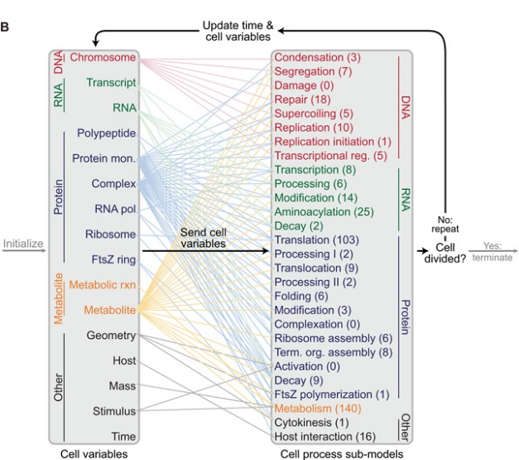
Goal of the project
Whole (Human) Cell Modeling and Simulation
Multiple scales = Multiple methods for modelling and simulation must be combined
Missing parameters (e.g., kinetic parameters)
Intrinsic stochasticity (e.g., signaling, gene regulation)
Synchronization and communication between the simulation methods is necessary
Massive amount of reactions and chemical species → massive calculations
Attempted by Karr et al. using model of bacterium M. genitalium (see scheme)
521 genes: enough for all basic processes
Never attempted on human cells
Figure taken from: Karr et al., A whole-cell computational model predicts phenotype from genotype, Cell 2012

Slide 3
Our approach
Combine phenomenological modelling/simulation techniques (e.g., Boolean networks, Fuzzy Rule-Based Models) with more detailed mechanistic approaches (e.g., differential equations, Markov chains)
Intensive computations (e.g., ODEs) will be offloaded on multiple GPUs
Fuzzy RB model defined by hand or (possibly?) automatically inferred from data
The various algorithms will run in a distributed fashion using MPI (master node collects partial results)
Stochastic simulation is one bottleneck of the method: we need a clever strategy to improve performances
We need to estimate a huge amount of parameters
We can automate the collection of biological data using Information Retrieval

Slide 4
Progress of the CS
Task A1
Accelerated stochastic biochemical simulation
Task A2
Integration of deterministic GPU-powered simulation
Task A3
Automatic FRBM model inference
Task A4
Metabolic modeling reduction and simulation
Task B1
Integration of stochastic simulator and FRBM
Task C1
Estimation of missing parameters
Task D1
Integration of all modeling approaches
Task Z1
Application to programmed cell death

Slide 5
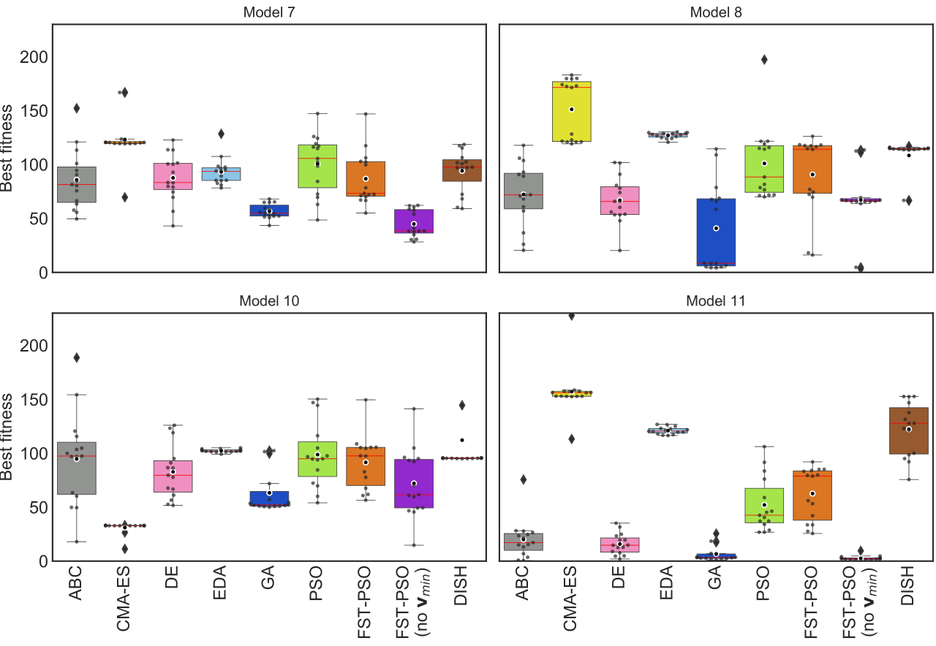
Estimation of missing parameters
Parameter Estimation can be stated as a minimization problem (i.e., minimize the «difference» between simulation and experimental data)
We are currently testing DISH (DIstance Based Parameter Adaptation for Succes-History based Differential Evolution), a variant of Differential Evolution
Among the state-of-the-art of evolutionary algorithms for global optimization
Preliminary tests: six biochemical models with 50 reactions (=missing parameters)
In silico generated target dynamic target data
Preliminary results are not satisfying – we will repeat the tests on more complex systems (>50 parameters)

Slide 6
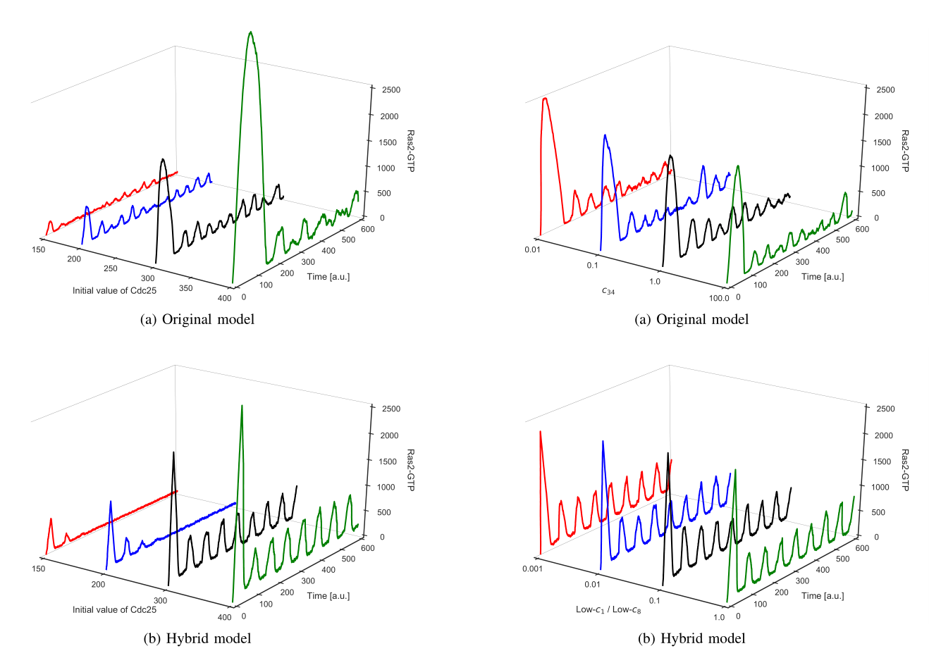
Hybridization of mechanistic and fuzzy rule-base models
Two «regimes» that communicate by means of a shared interface
In our tests, a FRBM was combined with a reaction-based model simulated using Gillespie’s Stochastic Simulation Algorithm (SSA)
Both modeling approaches require a massive domain expertise
In the preliminary tests the method was able to correctly reproduce complex phenomena using only a smaller fraction of computational effort
Spolaor et al., IEEE TFS (under revision)

Slide 7
Accelerated stochastic biochemical simulation
We are planning to model with Markovian Agents the concurrent reactions firing in the biochemical systema
Would be helpful to strongly improve the performances of the stochastic simulation
Represents a simplification with respect to pure SSA
See Bobbio et al., «Markovian Agent Models: A Dynamic Population of Interdendent Markovian Agents», 2016
Work in progress (no results)

Slide 8
Book chapter
A book chapter in forthcoming vol. 11400 of Lecture Notes in Computer Science was written by all group members
Topics: challenges of whole cell simulation, HPC and Big Data in life sciences, hybrid and multi-formalism modeling approaches, model reduction, kinetic parameters estimation, inference of fuzzy models

Slide 9
Next steps
We plan to exploit automatic model reduction to improve performances (and possibly reduce the number of missing parameters to be estimated)
Provide additional data for automatic inference of FRBM
Test estimation algorithms (DISH and FST-PSO in particular) on higher dimensional models
Test Chaos-driven PSO and multi-objective (e.g., NSGA-II)
Apply Markovian Agents to multi-scale tissue simulation

Slide 10
CS members
Daniela Besozzi
Paolo Cazzaniga
Luis Correia
Mauro Iacono
Joanna Kolodziej
Giancarlo Mauri
Ivan Merelli
Marco S. Nobile
Zuzana Komínková Oplatková
Sabri Pllana
Roman Senkerik
Simone Spolaor
Natalja Stojanovic
Esko Turunen
Aleš Zamuda

